Slide 1
Korean Dataset

Slide 2
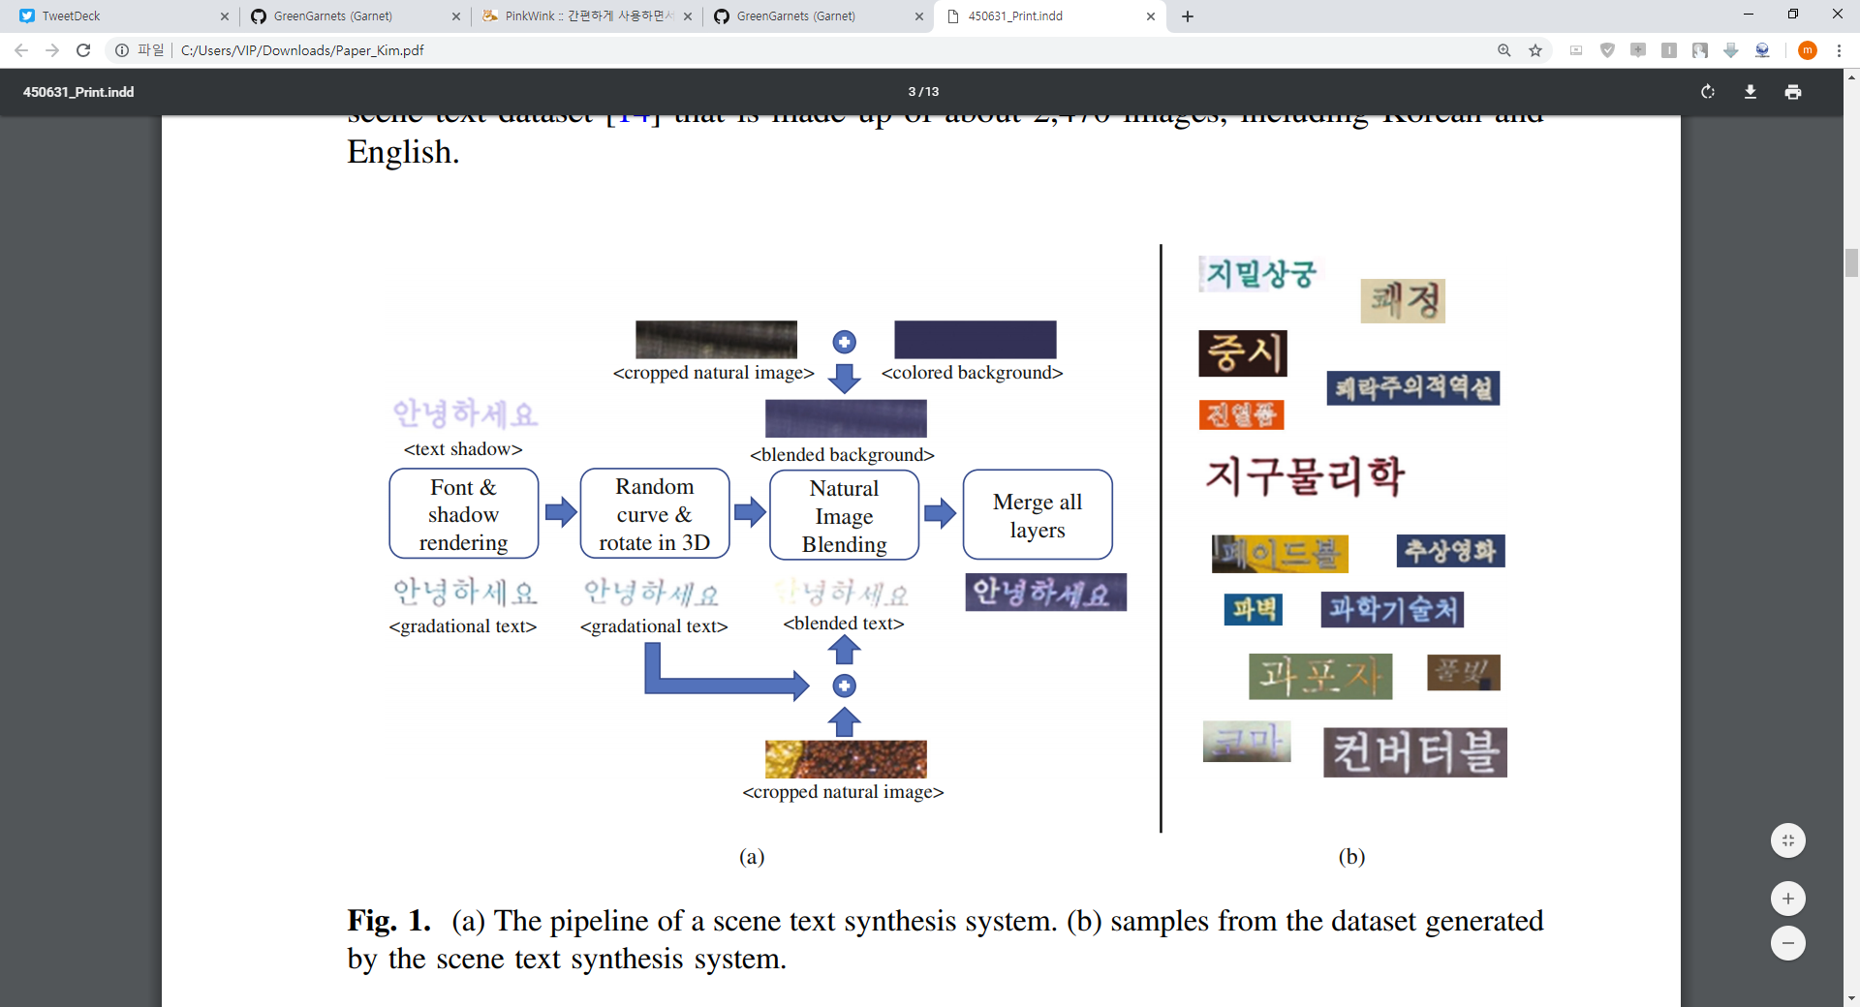
Korean Dataset Generator

Slide 3
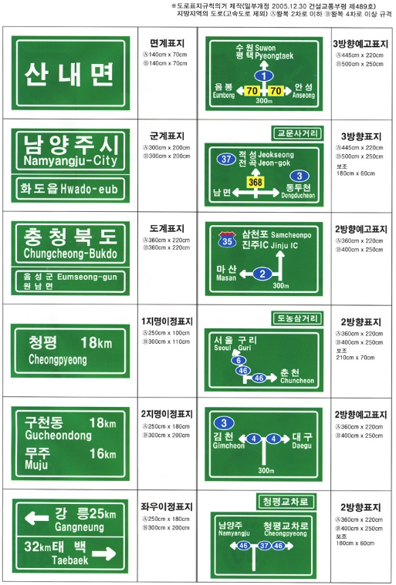
Korean Dataset Generator

Slide 4
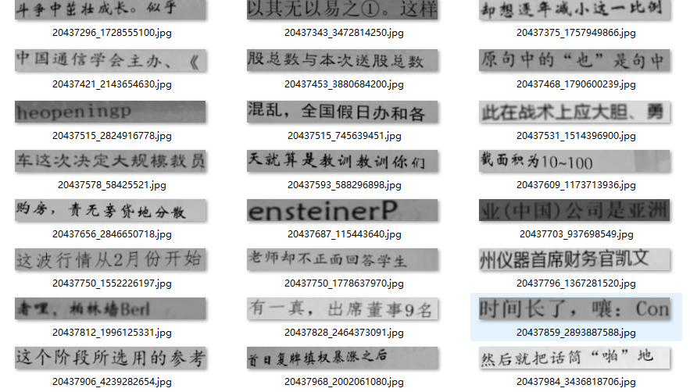
Dataset Generator -> https://github.com/Sierkinhane/crnn_chinese_characters_rec

Slide 5
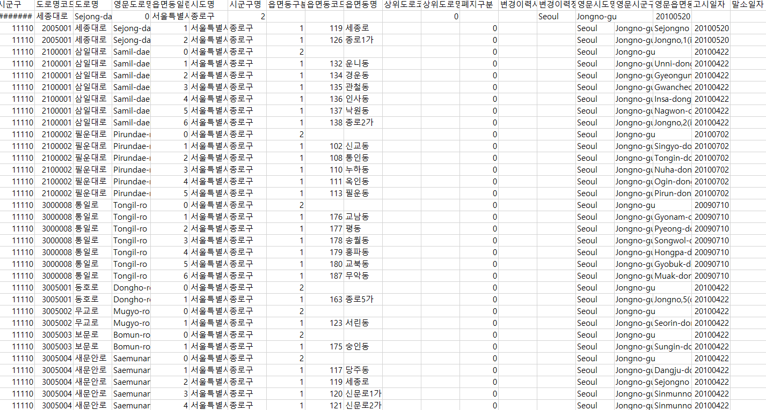
Word Generator

Slide 6
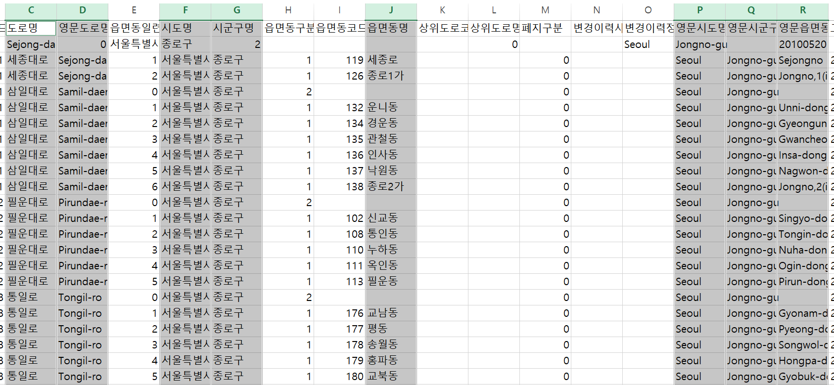
Word Generator

Slide 7
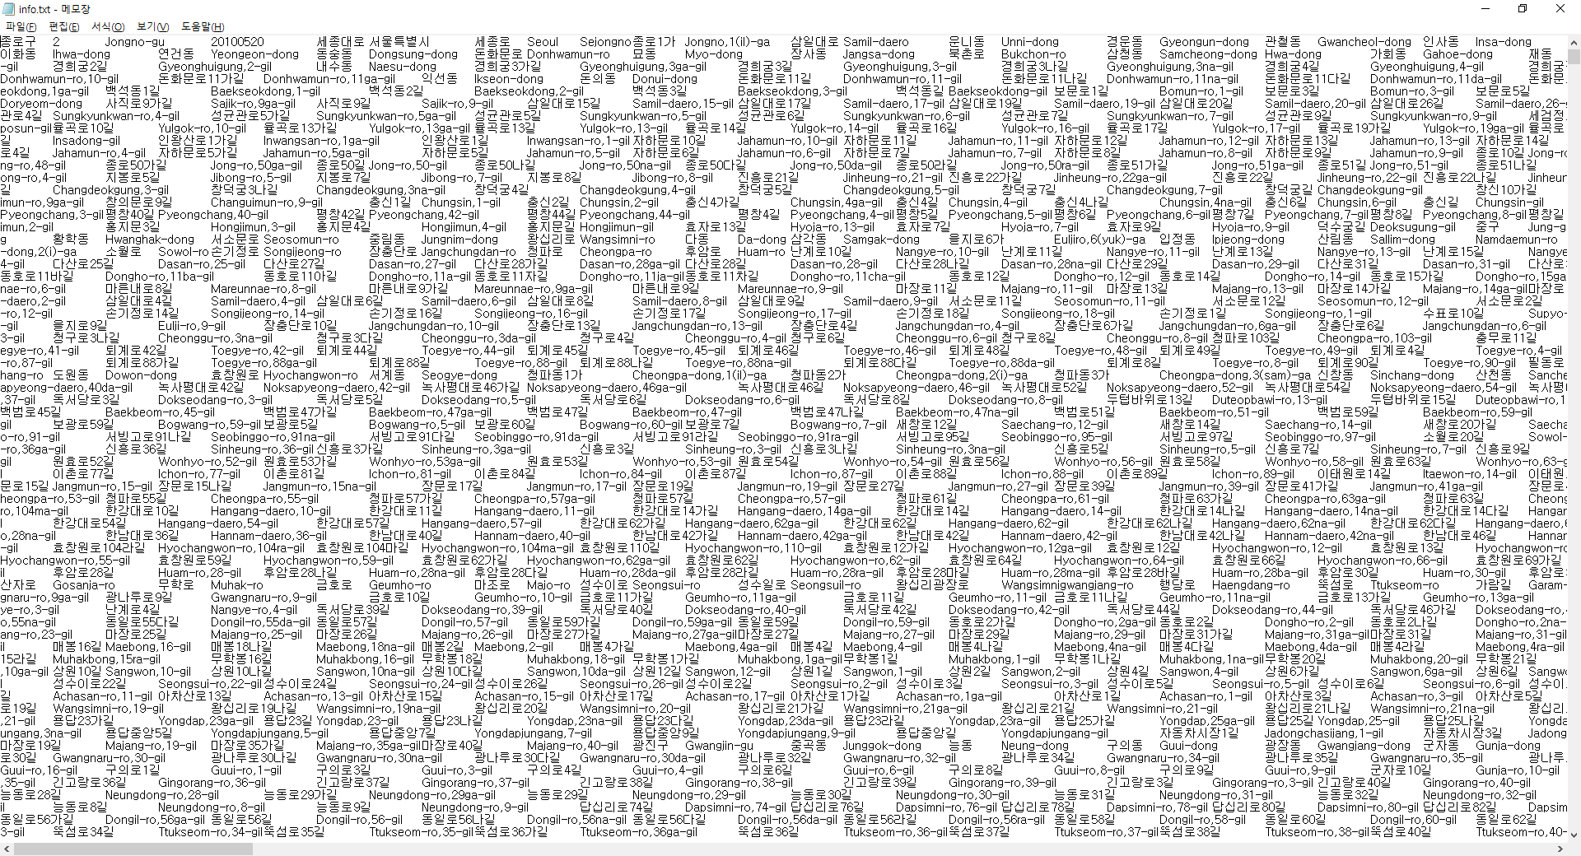
Word Generator, 272783 words

Slide 8
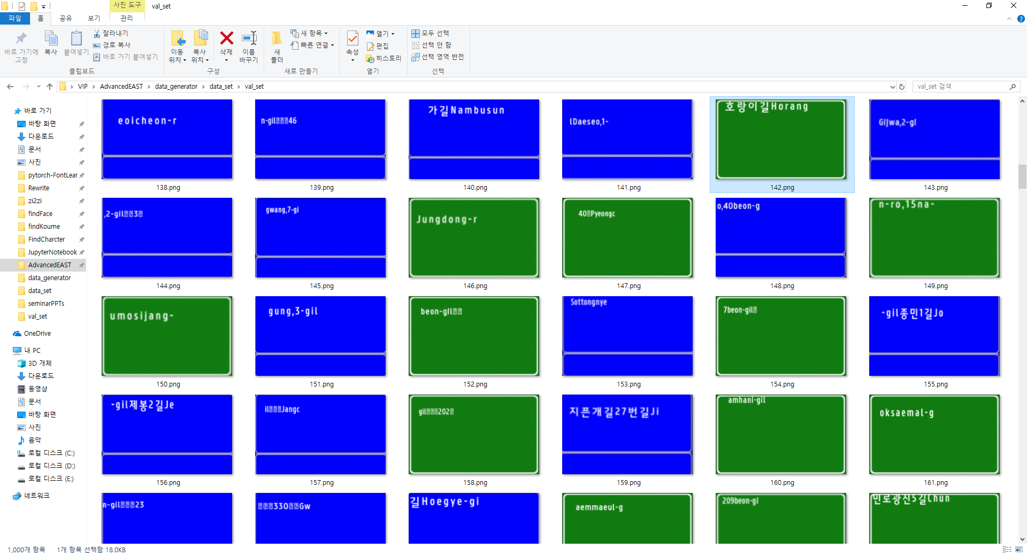
Korean Dataset Generator

Slide 9
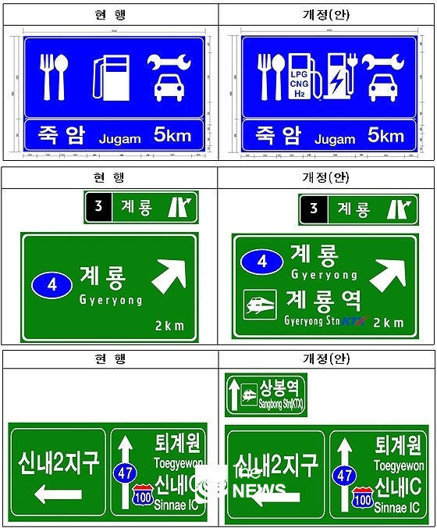

Korean Dataset Generator
표지판 생성 규칙
Text Position output

